Slide 1
Dr. Karl Petrick
Associate Professor of Economics, Western New England University
Coordinator, Middle East Council of American Chambers of Commerce/Western New England University Gulf Region Trade Data Project
Previously taught in Jamaica (2006-2008) and England (1999-2006)
Fields of research: macroeconomics, international trade, international finance, economic development

Slide 2
Overview: Positives
Longest economic expansion in U.S. history
Over 10 years, and counting
Inflation still subdued
‘All items’ Consumer Price Index (CPI)
December 2019: 0.2%
Year-on-year annual rate: (2019 estimate) 2.3%
Unemployment Rate low (I’ll come back to this)
All data from bls.gov

Slide 3
Overview: Headwinds
Every upturn eventually runs out of steam
Real GDP growth rates are slowing down (next slide)
The Official Unemployment Rate is only part of the story
All data from bls.gov

Slide 4
Global Context
2018 real GDP Growth, 2019-2021 Growth Forecasts (%)
 | 2018 | 2019 (e) | 2020 (f) | 2021 (f)
WORLD | 3.6 | 3.0 | 3.4 | 3.6
USA | 2.8 | 2.4 | 2.4 | 2.1
Canada | 1.9 | 1.5 | 1.8 | 1.8
Mexico | 2.0 | 0.4 | 1.3 | 1.9
Euro Zone | 1.9 | 1.2 | 1.4 | 1.4
UK | 1.4 | 1.2 | 1.4 | 1.5
Japan | 0.8 | 0.9 | 0.5 | 0.5
China | 6.6 | 6.1 | 5.8 | 5.9
All data, International Monetary Fund

Slide 5
Why The global context Matters for massacHusetts
MA goods exports (2018):
$27.2 billion
Main Trading Partners:
Canada (11.1%)
China (9.7%)
Mexico (9.2%)
Germany (7.2%)
Japan (5.5%)
MA goods imports (2018):
$35.6 billion
Main Trading Partners:
Canada (20.9%)
China (14.7%)
Mexico (9.7%)
Ireland (6.2%)
Germany (6.0%)
All data, U.S. Census Bureau

Slide 6
Trade Policy
Effect of U.S-China Trade Dispute
U.S. GDP decreased by 0.25%
Chinese GDP decreased by 0.30%
Global GDP decreased by 0.1% in 2017, estimated decrease of 0.8% in 2019 as a result
U.S. manufacturing badly hurt by U.S.-China, U.S. – EU trade disputes
Some loss of GDP is permanent
Lost supply chain links long-lasting if not permanent

Slide 7
OFFICIAL Unemployment Rate
 | U.S. | MA | Western MA*
November 2019 | 3.5 | 2.3 | 2.8
December 2019 | 3.5 | - | -
*average of Amherst, Belchertown, Chicopee, Greenfield. Holyoke, Northampton, Springfield, West Springfield, Westfield areas, not seasonally adjusted
U.S. Data from bls.gov, MA and Western MA data from mass.gov/lwd

Slide 8
What the unemployment rate doesn’t tell you
December 2019:
Labor Force Participation Rate: 63.2%
Still very low
Long-term unemployed: 1.2 million (20.5% of total)
‘Part Time for Economic Reasons’: 4.1 million people
‘Marginally Attached to the Labor Force’: 1.2 million
Adjusted for inflation, wages are stagnant
All data from bls.gov

Slide 9
‘real’ Unemployment Rate (u-6)
 | ‘Official’ (U-3) U.S. rate | U-6 rate | U-6 rate (MA)
October 2019 | 3.6 | 6.9 | -
November 2019 | 3.5 | 6.9 | -
December 2019 | 3.5 | 6.7 | -
Annual estimate |  | 7.3 | 6.3
All data from bls.gov
U-6 rate includes: ‘marginally attached’ and discouraged workers, people ‘employed part-time for economic reasons

Slide 10
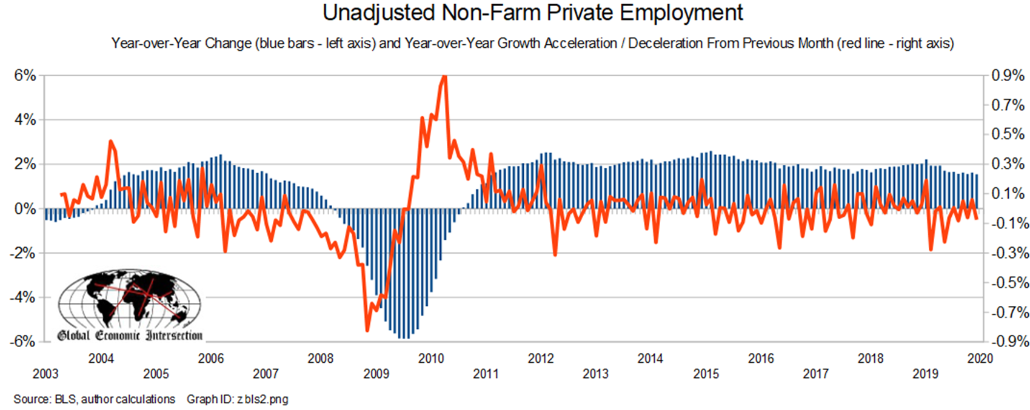
Year on year growth (red line) slowed down in December
Below growth rate in 2018
Source: http://econintersect.com/

Slide 11
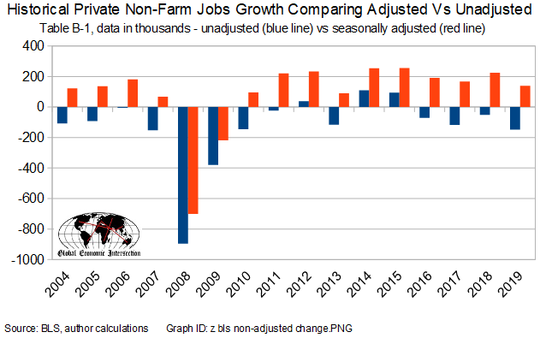
Year-to-date unadjusted employment growth is 597,000 people below the pace of last year
the worst year-to-date growth since 2010.
Source: http://econintersect.com/

Slide 12
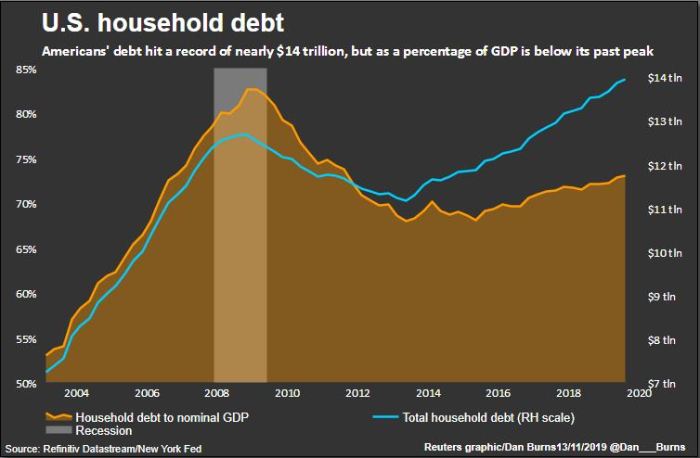
Household debt
Record high in $ terms ($13.9 trillion)
73% of GDP (as opposed to 86% of GDP in 2010)

Slide 13
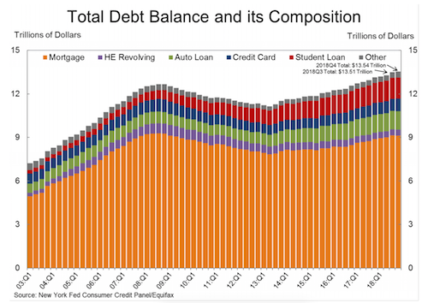
Composition of Household debt
Mortgages, student loans are the majority of household debt

Slide 14
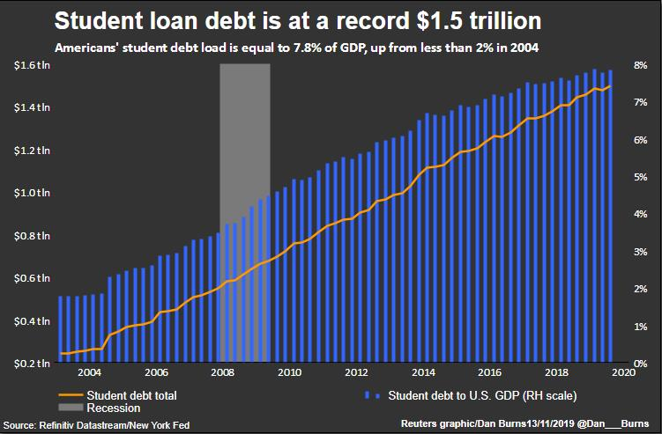
Student loans

Slide 15
Consumer Confidence index (December 2019)
Present Situations Index rose (166.6 to 170)
Based on current conditions
Expectations Index fell (100.3 to 97.3)
Based on short-term outlook
Consumers’ expectations less upbeat
Consumer spending and economic growth unlikely to gain momentum in the first half of 2020
Source: https://www.conference-board.org/data/consumerconfidence.cfm

Slide 16
OUTLOOK
Stock market still bulling along
Concerns about how stable the upturn is
Housing starts strong
Still below 2005 peak, and slower than growth in 1990s
Consumer confidence strong but weakening
Trade policy uncertainty hurts economic growth

Slide 17
Contact details
Dr. Karl Petrick
Western New England University
1215 Wilbraham Road
Springfield, MA 01119
Tel: 413-782-1601
email: kpetrick@wne.edu
website: https://www.karlpetrickeconomics.com/

