Slide 1
Are Trade Wars ‘Good’?
Are They ‘Easy to Win’?
Dr. Karl Petrick
Associate Professor of Economics
Western New England University
kpetrick@wne.edu
Jolicour Economic Seminar, Western New England University, 11/07/2019

Slide 2
Why Should It Be Easy?
U.S. Economy is very big
  GDP: @ $20.5 trillion (2018) (World Bank estimate, current U.S. $)
Largest economy in the world
@ 23.9% of the World Economy (World Bank)
U.S. is top export destination for @ 1/5 of the world’s countries

Slide 3
Why Should It Be Easy?
U.S. is much bigger than our trade partners:
  China: @ $13.6 trillion
  Japan: @ $4.9 trillion
  Germany: @ $3.9 trillion
  United Kingdom: @ $2.8 trillion
  France: @ $2.7 trillion
  India: @ $2.7 trillion
  Italy: @ $2.1 trillion
  Canada: @ $1.7 trillion
  South Korea: @ $1.6 trillion
  Mexico: @ $ 1.2 trillion
  All data World Bank, 2018 GDP, current U.S. $

Slide 4
Why Should It Be Easy?
Trade (imports and exports) = 27% of U.S. GDP
A smaller % than our trade partners:
  Germany: 87%
  South Korea: 83%
  Mexico: 80%
  Canada: 66%
  France: 63%
  U.K. /Italy: 61%
  India: 43%
  China: 38%
  Japan: 35%
  All data 2017, World Bank

Slide 5
Why Shouldn’t It Be Easy?
History: Countries retaliate with tariffs on U.S. products
Smoot-Hawley Tariff (Tariff Act of 1930)
U.S. tariffs raised to @ 60% on over 12,000 imported products
40 countries responded in kind
World trade fell by 2/3 in 3 years
U.S. exports collapsed

Slide 6
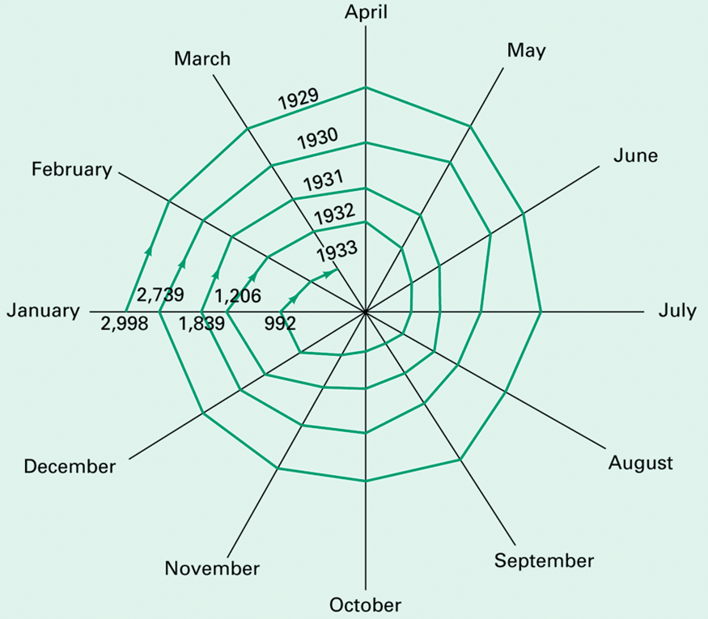
The Collapsing Spiral of World Trade, Jan 1929-March 1933
Total imports of 75 countries in millions of U.S. $
From: Kindleberger, 1973

Slide 7
Why It’s Definitely Not Easy Now
The Size of Really Big Business
Multinational Corporations are 10% of World GDP
MNC sales are @ 50% of World GDP
(data for 2015, World Bank)
The Growth of Intra-company Trade
Around 50% of U.S. trade is intra-company trade

Slide 8
Why It’s Definitely Not Easy Now
Companies are just international supply chains
In 2017, @ 15% of all U.S. imports were classified as intermediate goods used in U.S. production (World Bank), but other estimates go up to 50% of U.S. imports
Import of Intermediate Goods grew by 47% from 2009-2016 (U.S. International Trade Commission)
3 largest foreign sources of intermediate goods were Canada, China, and Mexico (U.S. ITC)

Slide 9
Why It’s Definitely Not Easy Now
The Substitution Effect?
Production of intermediate goods often heavily concentrated in a single location
  One city in China produces 80% of the world’s zippers and 60% of the world’s clothing buttons
It is difficult/impossible to find needed quantities from other sources if a trade war interrupts the global supply chain

Slide 10
Sources
GDP and trade data from the World Bank’s databank at: https://databank.worldbank.org/home.aspx
Material for ‘Size of Really Big Business’ and Intra-firm trade data from:
World Bank (June 2017), ‘Arm’s-Length Trade: A Source of Post-Crisis Trade Weakness’, http://pubdocs.worldbank.org/en/222281493655511173/Global-Economic-Prospects-June-2017-Topical-Issue-Arms-length-trade.pdf

Slide 11
Sources
Intermediate Goods trade data from:
Toreskar, Mihir (2017), ‘Intermediate Goods Imports In Key U.S. Manufacturing Sectors’, U.S. International Trade Commission, https://usitc.gov/research_and_analysis/trade shifts_2017/specialtopic.htm
And from the World Bank’s databank
Material r.e. the Smoot-Hawley Tariff and ‘The Collapsing Spiral of World Trade’ from Kindleberger, Charles (1973), The World in Depression, 1929-1939, University of California Press

